Slide 1
WEAVE: an online worked examples viewer
By Emilia Vulpe

Slide 2
What are worked examples?
Examples which are broken into different pieces
They are revealed gradually
Each step has an explanation

Slide 3
Why are worked examples beneficial for learning Computing Science?
Novices have a restricted knowledge of the problem domain
Worked examples can help in gaining the necessary expertise to solve problems

Slide 4
Problems of the existing forms of worked examples
Do not provide enough interactivity
May not fit into the teaching needs
Provide little or no feedback

Slide 5
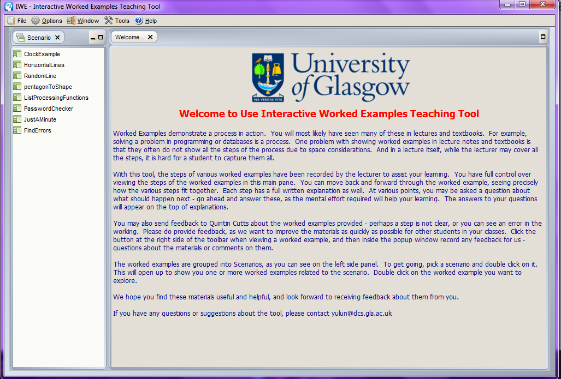
A solution to these problems

Slide 6

The context of worked examples in this Level 4 project

Slide 7

Why not use IWE in schools?
It is difficult to install!

Slide 8

An alternative

Slide 9
Other benefits
It will receive the latest updates of the application and the worked examples
Will enable sharing examples on national and even international level

Slide 10
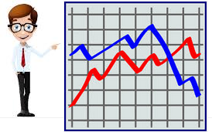
Taking a step further…

Slide 11

A necessary condition

Slide 12
Goals for this project
Build a web-based viewing system that is interoperable with the author interface of IWE
Provide an interface for teachers that will help them gain more information on how the worked examples are used by their own pupils
Replicate as closely as possible the student interface of IWE
Ensure that worked example authors can view usage data in an anonymous manner, such that individual pupils, classes or schools are not identifiable

Slide 13
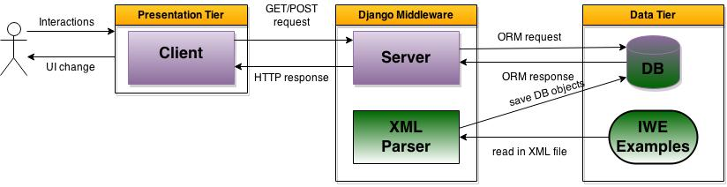
Architecture

Slide 14
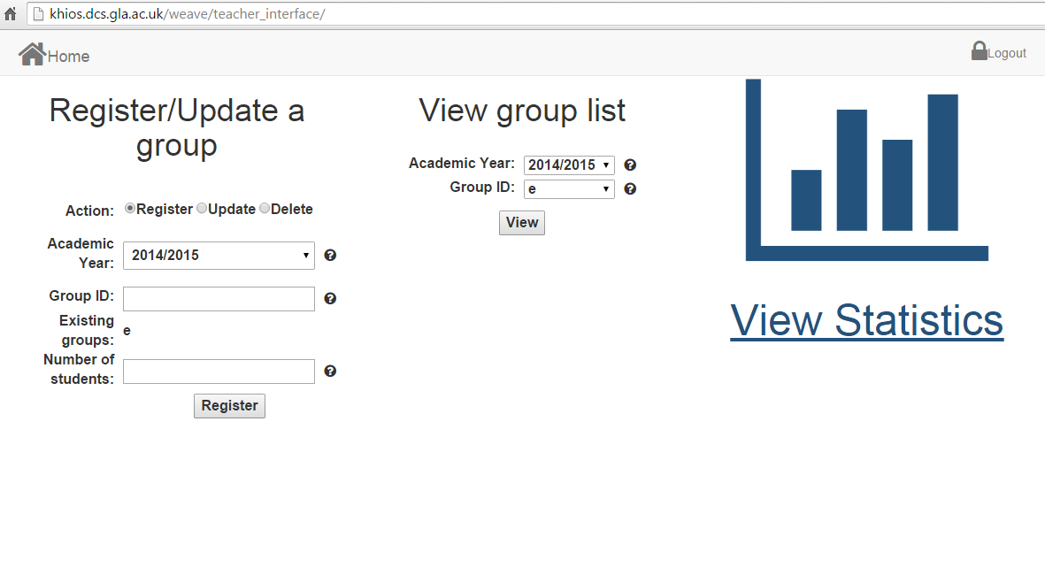
Teacher Interface

Slide 15
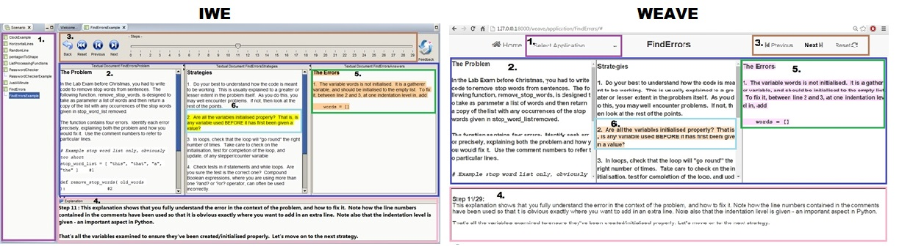
Student Interface

Slide 16
Evaluation
Usability Evaluation conducted with participants who are not teachers or students in Computing Science
Heuristics Evaluation conducted with experts in Django web application development
Usability Evaluation with teachers in schools
Practical Evaluation with a secondary school teacher

Slide 17
Future work
Satisfy teachers’ needs
Provide an author interface
Make revolution in teaching practices in schools?

Slide 18

Thank you!

Slide 19
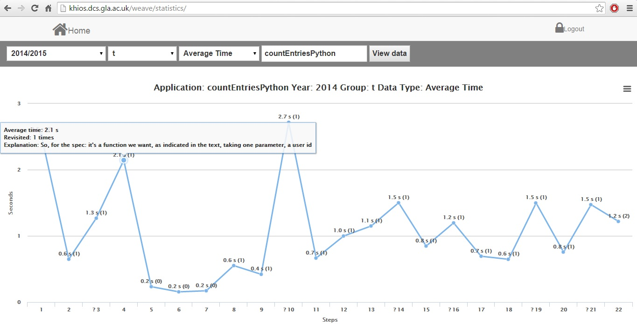
View Statistics Page

Slide 20
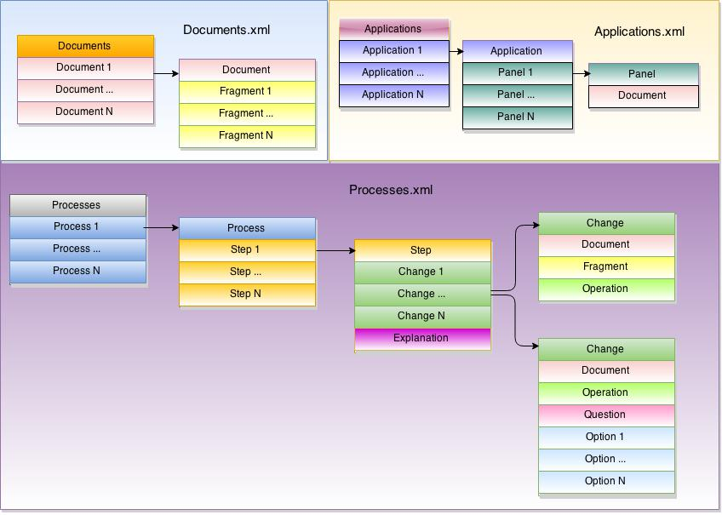
IWE Examples Structure

